Slide 1
Unit 5. System Modeling

Slide 4
System modeling
System modeling is the process of developing abstract models of a system, with each model presenting a different view or perspective of that system.
System modeling has now come to mean representing a system using some kind of graphical notation, which is now almost always based on notations in the Unified Modeling Language (UML).
System modelling helps the analyst to understand the functionality of the system and models are used to communicate with customers.

Slide 5
Existing and planned system models
Models of the existing system are used during requirements engineering.
They help clarify what the existing system does and can be used as a basis for discussing its strengths and weaknesses.
These then lead to requirements for the new system.
Models of the new system are used during requirements engineering to help explain the proposed requirements to other system stakeholders.
Engineers use these models to discuss design proposals and to document the system for implementation.
In a model-driven engineering process, it is possible to generate a complete or partial system implementation from the system model.

Slide 6
System perspectives
An external perspective, where you model the context or environment of the system. (Context Model)
An interaction perspective, where you model the interactions between a system and its environment, or between the components of a system. (Interaction Model)
A structural perspective, where you model the organization of a system or the structure of the data that is processed by the system. (Structural Model)
A behavioral perspective, where you model the dynamic behavior of the system and how it responds to events. (Behavioral Model)

Slide 7
Use of graphical models
As a means of facilitating discussion about an existing or proposed system
As a way of documenting an existing system
As a detailed system description that can be used to generate a system design finally leading to implementation.
UML: Unified Modeling Language

Slide 8
UML
The Unified Modeling Language (UML) is a general-purpose modeling language
Intended to provide a standard way to visualize the design of a system
Developed by Grady Booch, Ivar Jacobson and James Rumbaugh at Rational Software in 1994–1995, with further development led by them through 1996
In 1997, UML was adopted as a standard by the Object Management Group (OMG), and has been managed by this organization ever since.
In 2005, UML was also published by the International Organization for Standardization (ISO) as an approved ISO standard.

Slide 9
UML
Dynamic Models
Behavior diagrams emphasize what must happen in the system being modeled
Ex: Use Case Diagram, Activity Diagram, State Transition Diagram, Sequence Diagram
Static Models
Structure diagrams emphasize the things that must be present in the system being modeled
Ex: Class diagram, CRC Index, Object diagram, Component diagram, Deployment diagram

Slide 10
Context models
Context models are used to illustrate the operational context of a system - they show what lies outside the system boundaries.
Social and organisational concerns may affect the decision on where to position system boundaries.
Architectural models show the system and its relationship with other systems.

Slide 11
System boundaries
System boundaries are established to define what is inside and what is outside the system.
They show other systems that are used or depend on the system being developed.
The position of the system boundary has a profound effect on the system requirements.
Defining a system boundary is a political judgment
There may be pressures to develop system boundaries that increase / decrease the influence or workload of different parts of an organization.

Slide 12
Process perspective
Context models simply show the other systems in the environment, not how the system being developed is used in that environment.
Process models reveal how the system being developed is used in broader business processes.
0 Level data flow diagram may be used to represent the context model
May also be represented as Block diagram of sub-systems

Slide 15
Interaction Models
Modeling user interaction is important as it helps to identify user requirements.
Modeling system-to-system interaction highlights the communication problems that may arise.
Modeling component interaction helps us understand if a proposed system structure is likely to deliver the required system performance and dependability.
Use case diagrams and sequence diagrams may be used for interaction modeling.

Slide 18
Structural models
Structural models of software display the organization of a system in terms of the components that make up that system and their relationships.
Structural models may be static models, which show the structure of the system design, or dynamic models, which show the organization of the system when it is executing.
You create structural models of a system when you are discussing and designing the system architecture.

Slide 19
Class diagrams and CRC Index
Class diagrams are used when developing an object-oriented system model to show the classes in a system and the associations between these classes.
An object class can be thought of as a general definition of one kind of system object.
An association is a link between classes that indicates that there is some relationship between these classes.
When you are developing models during the early stages of the software engineering process, objects represent something in the real world, such as a patient, a prescription, doctor, etc.

Slide 20
Class diagrams
Class Identification
1.Hierarchical Object Oriented Design (HOOD) Approach
English Grammar Based Approach
Common Nouns: Class
Verb: Methods
Adjectives: Attributes
2. SOLID Principles
Single Responsibility Principle
Open-Closed Principle
Liskov’s Substitution Principle
Interface Segregation Principle
Dependency Inversion Principle

Slide 21
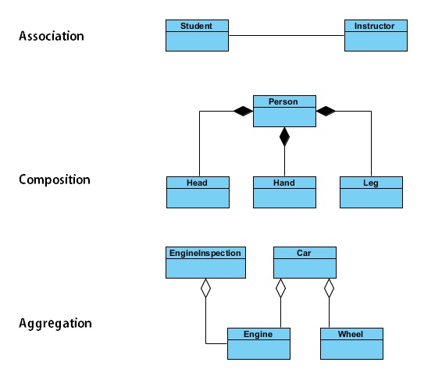
Class diagrams
Relationships

Slide 22
Class diagrams
Visibility
Private ( - ) :
A private member is visible only from within the class
Protected ( # ) :
A protected member is visible from within the class and from the subclasses inherited from this class
Public ( + ) :
A public member is visible from anywhere in the system

Slide 26
Behavioural Model
Behavioral models are models of the dynamic behavior of the system as it is executing
They show what happens or what is supposed to happen when a system responds to a stimulus from its environment
You can think of these stimuli as being of two types:
Data: Some data arrives that has to be processed by the system
Events: Some event happens that triggers system processing. Events may have associated data but this is not always the case
Sequence diagram and State Transition Diagram may be used for Behavioural Modeling

Slide 28
Data modeling
Data modeling is the analysis of data objects and their relationships to other data objects
Data modeling is often the first step in database design
Two Models
Flow Model:
Shows the movement of data from source to the sink
Data Flow Diagram is used for modeling the flow
Relationship Model:
Shows the relation between different objects of the system
Entity-Relationship (ER) diagram is used for modeling the flow

Slide 29
Data modeling
Data Flow Diagram
A data-flow diagram (DFD) is a way of representing a flow of a data of a process or a system
The DFD also provides information about the outputs and inputs of each entity and the process itself
A data-flow diagram has no control flow, there are no decision rules and no loops
Levels: 0, 1, 2 … n Level DFD

Slide 30
Data modeling
Data Flow Diagram
Components of DFD
Entity
An external entity that communicates with the system and stands outside of the system.
An entity may be another system with which the modeled system communicates
Process
The process (function, transformation) is part of a system that transforms inputs to outputs
Database
database is used to represent storage of data for later use
Flow
flow shows the transfer of information (sometimes also material) from one part of the system to another

Slide 31
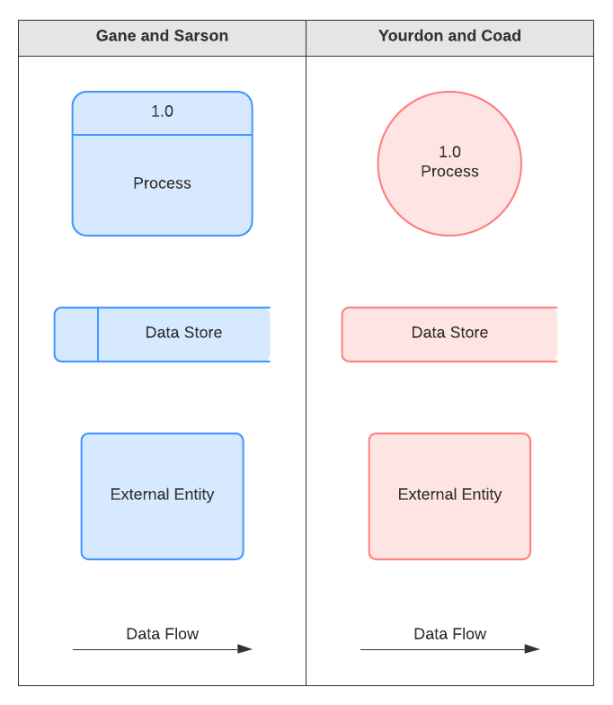
Data modeling
Data Flow Diagram
Notations:

Slide 37
Data modeling
ER Diagram
The ER or (Entity Relational Model) is a high-level conceptual data model diagram
Entity-Relation model is based on the notion of real-world entities and the relationship between them
Components of the ER Diagram
Entities
Attributes
Relationships

Slide 38
Data modeling
ER Diagram

Slide 42
Model-Driven Architecture
Model-driven architecture is a software design approach that provides a set of guidelines for the structuring of specifications, which are expressed as models
It was launched by the Object Management Group (OMG) in 2001
Model-driven architecture supports model-driven engineering of software systems
Model-driven engineering focuses on creating and using domain models, which are conceptual models of all the topics related to a specific problem.
It highlights and aims at abstract representations of the knowledge and activities rather than the algorithmic concepts.

Slide 43
Model-Driven Architecture
MDA focuses on developing a domain model which is a conceptual model of the problem domain
The domain model incorporates both behavior and data
A domain model is a formal representation of a knowledge domain with concepts, roles, data-types, individuals, and rules, typically grounded in a description logic
In the Unified Modeling Language (UML), a class diagram is used to represent the domain model

